Slide 1
Customer Churn Analysis for Airline Data
Ian Ustanik and Rishabh Agarwal

Slide 2
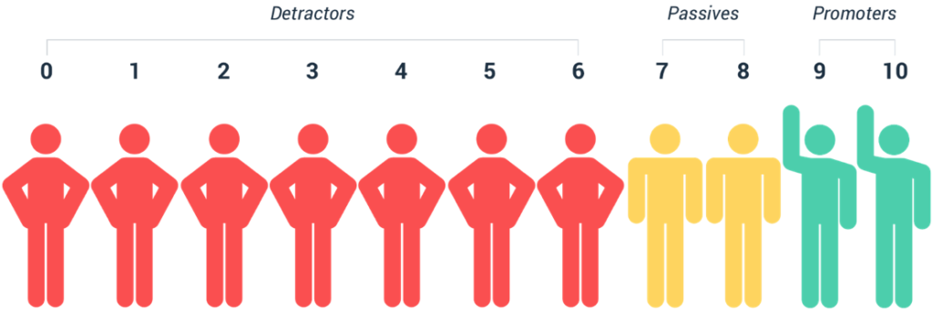
About the Data
The dataset contains the demographics and additional information for the passengers who had travelled with FlyFast, Cheapseats and Sigma Airlines for individual flights in the first quarter of 2014.
The dataset contains attributes such as Age, Gender, Price sensitivity, Number of frequent flyer accounts, Travel date, information on the ticket bought (Class, Airline status, Type of ticket), Departure and Arrival city, flight information (Status, Flight distance and Flight time), Feedback and the Likelihood to recommend score.
The aim is to analyze the reasons for the customer satisfaction ratings (NPS) achieved by the three airlines and suggest data driven insights to improve the ratings for FlyFast Airways, converting detractors and passives into promoters.

Slide 3

Key Factors Affecting Customer Ratings
Type of travel - Business, Personal and Mileage
Airline status - Blue, Gold, Platinum, Silver
Age - 15-85
Gender - Male, Female
Flights per year - 0-89
Loyalty - between -1 and 1
Arrival delay in minutes - delay in flight arrival
Class - Eco, Eco+ and Business
Origin state and Destination state - departure and arrival state
Price sensitivity - 0-4

Slide 4
Exploratory Data Analysis
After cleaning the dataset, unsupervised forms of machine learning such as Association Rule Mining and K-means Clustering Analysis were applied to understand interesting patterns in the data.
The feedback provided by the customers have been analyzed by creating word clouds and sentence level sentiment analysis using the Liu Hu test to better understand and get to the root of the issues.
Machine learning algorithms such as Neural Networks, Random Forests, and Support Vector Machines were applied to create supervised learning models used to predict and classify whether a passenger is likely to be a promoter, detractor or passive for various segments when exposed to new data.
Algorithm
Jupyter Notebook Accuracy
Orange Workflow Accuray
Algorithm Details
Random Forest
87.27%
97.90%
Classification
1
Neural Network
65.20%
91.50%
Deep Learning
2
Support Vector Machine
98.40%
71.50%
Classification
3

Slide 5
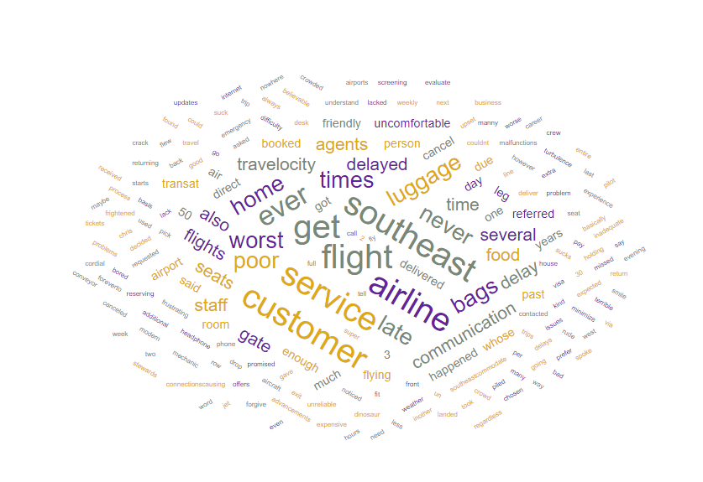
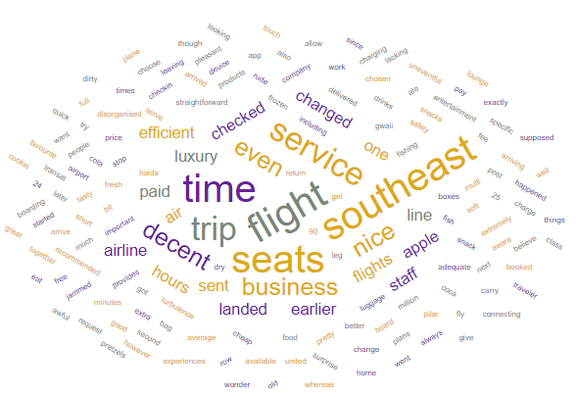
Word Level Analysis of the Feedback for FlyFast
Promoter Feedback
Detractor and Passive Feedback

Slide 6
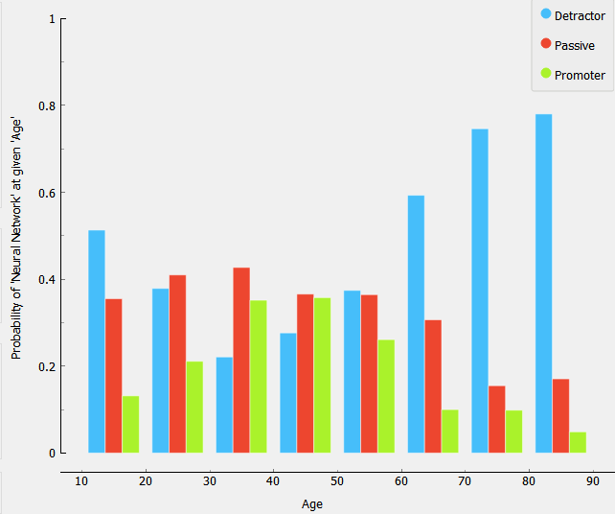
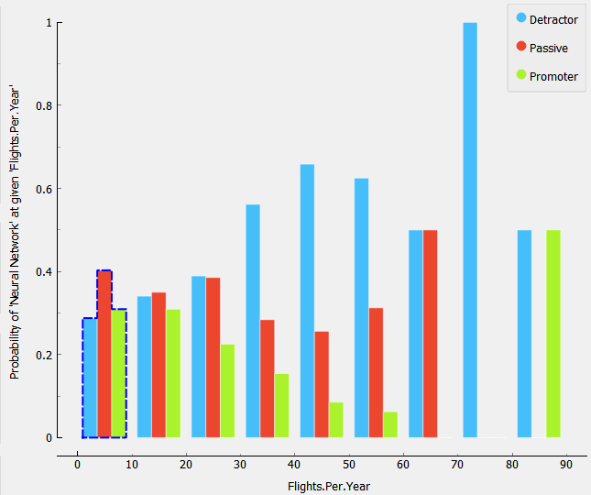
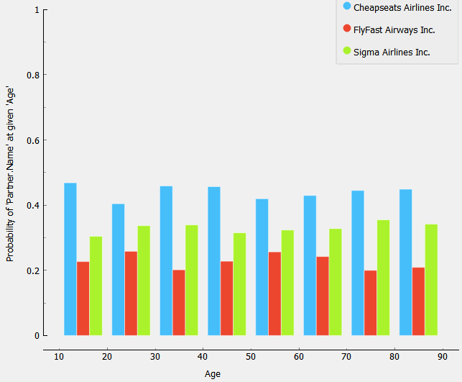
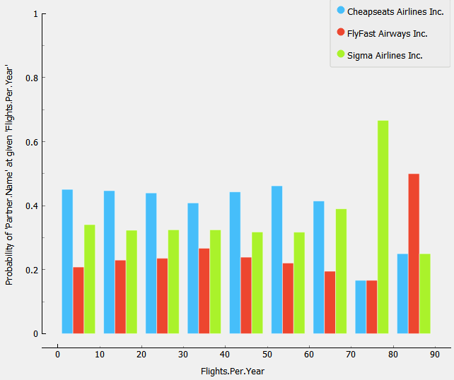
Age
Flights per Year
FlyFast
FlyFast

Slide 7
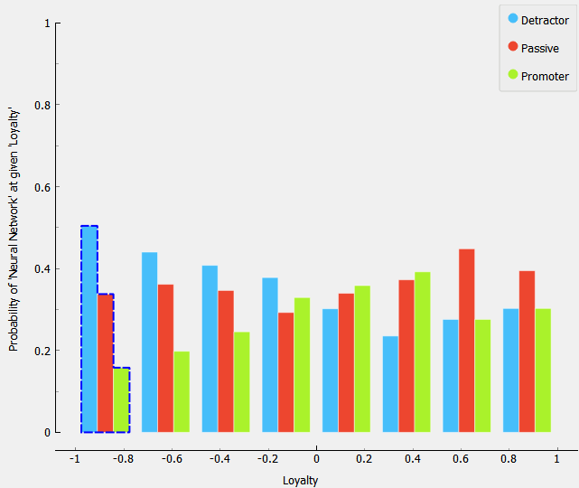
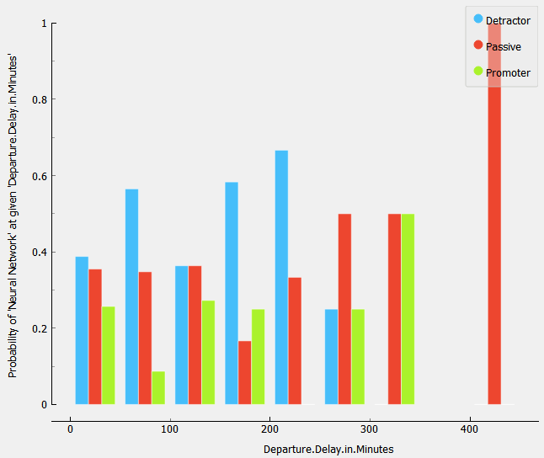
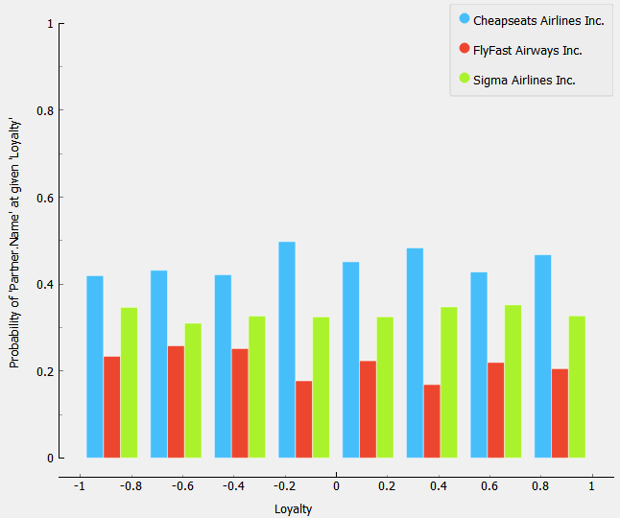
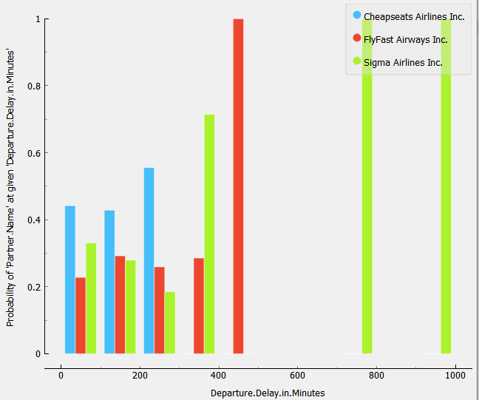
Loyalty
Departure Delay in Minutes
FlyFast
FlyFast

Slide 8
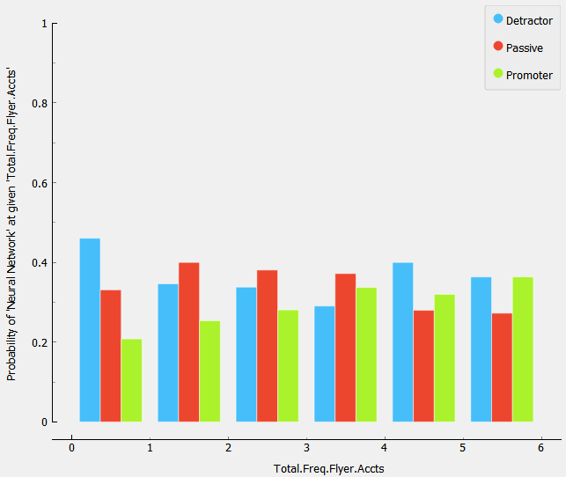
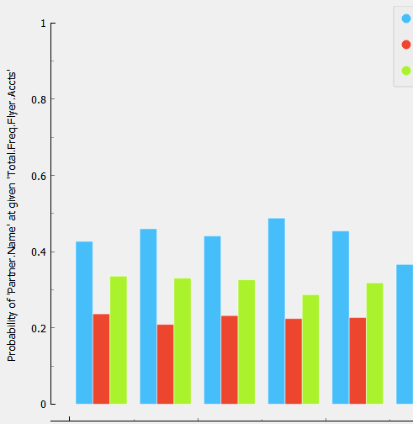
Total Frequent Flyer Accounts
FlyFast

Slide 9

Marketing Personas - Sigma
Sigma (Promoters)
Name: Ms. Pamela Cooper
Age: 32
Gender: Female
Location: New York
Education: Bachelor of Arts
Family members: 3
Occupation: Arts faculty at NYU
Work role info: Pamela travels for leisure purposes mostly to visit art exhibitions. Comfort, price and Leisure are important factors; because of which she chooses Sigma.
Marketing message: In-flight entertainment, food and beverage quality and comfort are the things which have resulted in her being satisfied with her travel experience. Maybe signing up for a frequent flyer account can help in customer retention.

Slide 10

Marketing Personas - Cheapseats
Cheapseats (Promoters)
Name: Mr. Ron Bryant
Age: 20
Gender: Male
Location: California
Education: Engineering student at USC
Family members: 2
Occupation: Student
Work role info: Ron travels for leisure purposes and sometimes to attend seminars. Price and food are an important factor and because of this, he chooses to fly with Cheapseats.
Marketing message: Mostly young travelers prefer travelling with Cheapseats as price is a major factor for them. Digital and email marketing campaigns with promotions targeting the younger age groups can help to attract more of them. If the flight is not full then they should be considered for an upgrade. Improving in-flight entertainment services can act as an added advantage.

Slide 11

Marketing Personas - FlyFast
FlyFast (Promoter)
Name: Mr. John Wick
Age: 40 (35-55)
Gender: Male
Location: Texas
Education: MBA
Family members: 4
Occupation: VP (marketing) at Schlumberger
Work role info: Being a high-ranking employee, John has to travel to various company locations to handle the various marketing campaigns. Time and comfort being important factors for him, he chooses to fly with FlyFast.
Marketing message: Since majority of the promoters are business travel passengers between the ages 35-55, FlyFast should look at the possibility of corporate tie-ups (B2B) which could act as a steady source of revenue. To woo more business passengers and improve on their customer retention (loyalty score), they should offer them bonus miles, improve their airport lounges, express check-in, offer extra baggage allowance, and if the flight gets delayed passengers should be compensated accordingly in addition to special food and beverage options. We believe these factors could make them choose FlyFast even for their leisure travel.

Slide 12

Marketing Personas - FlyFast
FlyFast (Detractors)
Name: Mrs. Sue Brady
Age: 65 (55-75)
Gender: Female
Location: Georgia
Education: BS in Finance
Family members: 6
Occupation: Retired
Work role info: Sue travels quite often to Colorado to visit her children and grandchildren and chooses FlyFast because time and comfort are important factors for her.
Marketing message: Since most of the detractors are in the age group (55-75) and mostly female passengers, FlyFast should introduce special assistance services for the elderly travelers such as express check-in, baggage handling and wheelchair assistance, in-flight special care and assistance and better in-flight entertainment services. Another good option could be to upgrade the passenger to business class if the flight is not running full.

Slide 13

Marketing Personas - FlyFast
FlyFast (Passives)
Name: Mr. Vincent Chase
Age: 28
Gender: Male
Location: Illinois
Education: MS in Supply Chain
Family Members: 2
Occupation: Supply Chain Analyst at FedEx
Work role info: Being a supply chain analyst, Vincent has to visit many of the company’s warehouses. He ends up taking almost 60-70 flights per year, so time is an important factor for him.
Marketing message: Since a major chunk of the passengers between 20-40 are passives and are travelling for business purposes, FlyFast should consider compensating the travelers if the flight is delayed. They should be compensated and accommodated for a different flight as it is severely affecting their experience.

Slide 14
Business Insights
A common theme amongst detractors for the sentiment analysis was that food quality and dealing with luggage were two main issues. Another issue was having to pay to choose the seats that customers wanted. Providing better food and figuring out how to fix luggage problems would help FlyFast. Ending the policy of having to pay to choose seats would also help against losing customers that have a high price sensitivity.
Passengers who are highly price sensitive tend to be detractors and passives. People who fly frequently shouldn’t be charged for choosing their seats of choice and giving more miles to them could help in retaining them, as they generate the most business for FlyFast. Sending promotional emails during the lean periods could help in attracting them.
Since FlyFast has the highest number of passives for the business travelers flying on the blue status airline, it would make sense to improve the in-flight entertainment services, and offer early/priority check-in, luggage assistance in terms of baggage allowance, better food/refreshments on flight and in the airport lounges to improve their experience.
FlyFast airlines has an enormous issue with providing excellent service to Economy and Economy Plus customers. Avoiding service polarity and lessening the experience gap between these customers and business class would be a great start to converting large numbers of detractors into promoters. Also offer a more luxurious experience overall to passengers who pay more. Platinum and Silver passengers should more often than not be promoters. They currently do not feel like their investment is paying off.

Slide 15
Business Insights
Since FlyFast airlines has the most number of passives and detractors for female passengers who are travelling for personal reasons, it would make sense to offer them special assistance in terms of food and service, improved in-flight entertainment services, and giving them seats with more leg room as they may be travelling with their children and comfort would be an important criteria for them.
There are the highest number of detractors when the flight is cancelled (or arrival delayed) by more than 100 minutes, so it may make sense to give them bonus miles or free access to the airport lounges. Offering them accommodations if the flight is delayed by more than 600 minutes could help in reducing the detractors and passives. If they miss their connecting flight as a result of the delay, they should be given compensation or be scheduled in another flight.
People in the age group from 10-20 were predominantly detractors. This is due to them being bored and uncomfortable during the flight. More in-flight entertainment (cockpit tour) and a higher frequency of food and drinks would help convert this demographic to being promoters. Passengers older than 65 were also likely to be detractors. Although it is difficult for people this age to be comfortable, perhaps senior discounts, early/priority check-in, luggage assistance, and more drinks would help.

